Slide 1
Unit 4
Physical Mobility

Slide 2
Physical Mobility
Mobile IP, goals assumption and requirement, Entities and terminology, IP packet delivery, agent advertisement and discovery, Registration, tunnelling and encapsulation, Optimizations, Reverse tunnelling, IPv6; Dynamic host configuration protocol, Traditional TCP: Congestion control, slow start, fast Retransmit/ fast recovery, implications on mobility; indirect TCP, snooping TCP, Mobile TCP, fast retransmit/ fast recover, Transmission/ time-out freezing, selective Retransmission, Transaction oriented TCP,TCP over 2.5/3G wireless networks, Performance enhancing proxies

Slide 3

Mobile IP
BY:
Ms. Ankita Nagmote

Slide 4
Contents
Introduction to Internet
Traditional IP address
3. Mobile IP and its Functions
4. Working of Mobile IP
Applications and Challenges
Agent advertisement and discovery, Registration, tunnelling and encapsulation, Optimizations, Reverse tunnelling,

Slide 5
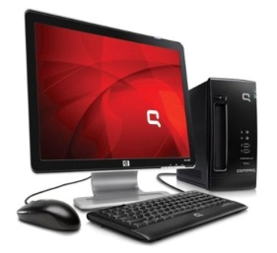

Introduction
Internet – Network for global data communication Server
Every device in a network is identified by a 32 bit unique number called as IP address
A
B
INTERNET
192.168.2.2
225.168.3.2
(11000000.10101000.00000010.00000010 )
(11100001.10101000.00000011.00000010 )

Slide 6
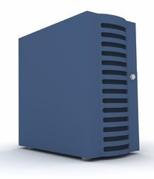



Traditional IP address technique
Changed IP address
Server
ISP
This is not feasible for portable devices
Client
Stationary
IP address
Server
IP address : 192.168.3.1

Slide 7
Mobile IP
Mobile IP is an open standard, defined by the Internet Engineering Task Force (IETF) by which, one can keep the same IP address, stay connected, and maintain ongoing applications while roaming between IP networks.
Functions of Mobile IP include:
Agent Discovery
Registration
Tunneling

Slide 8




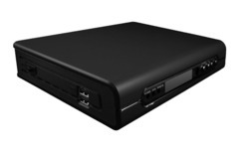
Working of Mobile IP
Other nodes in the Network
Care-of-Address
Mobile node A
3
4
2
Home Agent
Foreign Agent
Mobile
node A
INTERNET
Foreign Network
5
Home Network of A
1
Correspondent Node X

Slide 9
Terminologies (Components of MIP)
A Mobile Node (MN): It is the hand-held communication device that the user carries e.g. Cell phone.
A Home Network: It is a network to which the mobile node originally belongs as per its assigned IP address (home address).
Home Agent (HA): It is a router in-home network to which the mobile node was originally connected
Home Address: It is the permanent IP address assigned to the mobile node (within its home network).
Foreign Network: It is the current network to which the mobile node is visiting (away from its home network).
A Foreign Agent (FA): It is a router in a foreign network to which the mobile node is currently connected. The packets from the home agent are sent to the foreign agent which delivers them to the mobile node.
The Correspondent Node (CN): It is a device on the internet communicating to the mobile node.
Care-of Address (COA): It is the temporary address used by a mobile node while it is moving away from its home network.
Foreign Agent COA: The COA could be located at the FA, i.e., the COA is an IP address of the FA. The FA is the tunnel end-point and forwards packets to the MN. Many MN using the FA can share this COA as a common COA.
Co-Located COA: The COA is co-located if the MN temporarily acquires an additional IP address that acts as a COA. This address is now topologically correct, and the tunnel endpoint is at the MN.

Slide 10
Agent Discovery
Agents advertise their presence by periodically broadcasting their agent advertisement messages.
The mobile node receiving the agent advertisement messages observes whether the message is from its own home agent and determines whether it is in the home network or foreign network.
Agent advertisement
Agent Solicitation

Slide 11
Agent Registration
Mobile node after discovering the foreign agent sends a Registration Request (RREQ) to the foreign agent.
The foreign agent, in turn, sends the registration request to the home agent with the care-of-address. The home agent sends a Registration Reply (RREP) to the foreign agent.
Then it forwards the registration reply to the mobile node and completes the process of registration.

Slide 12
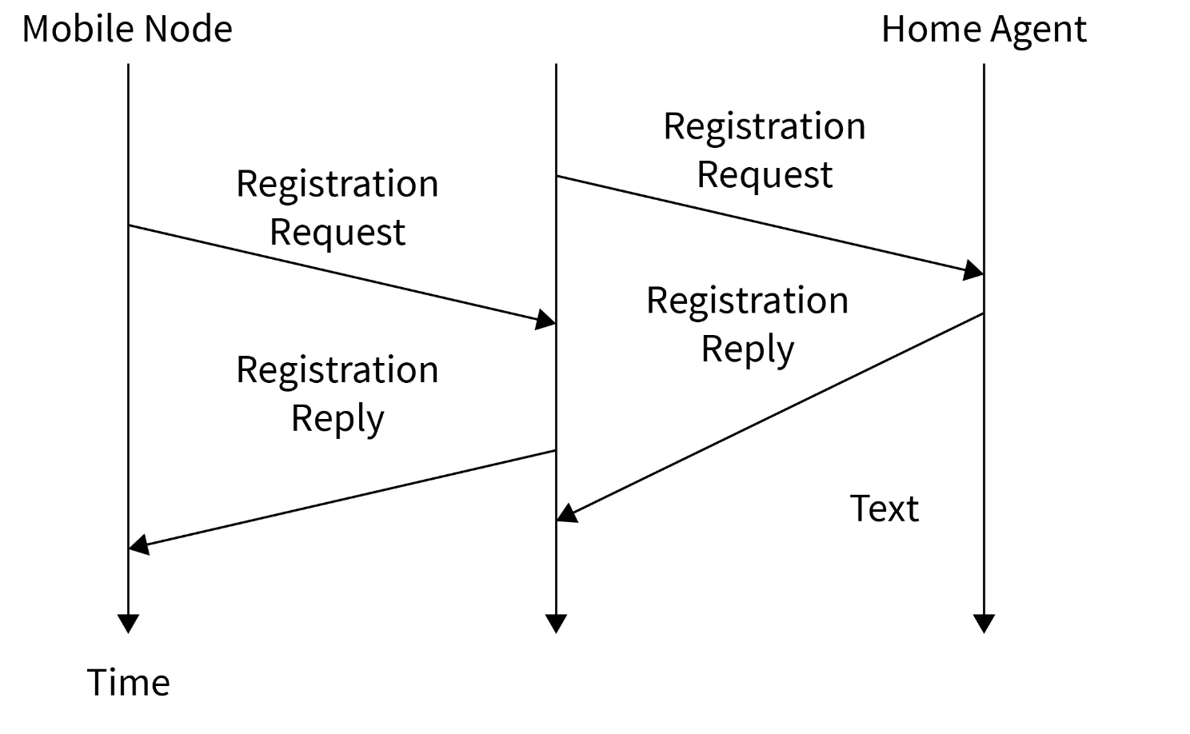
Agent Registration

Slide 13
Tunneling and Encapsulation
Tunneling is the process of sending a packet via a tunnel and it is achieved by a mechanism called encapsulation.
It establishes a virtual pipe for the packets available between a tunnel entry and an endpoint.
It takes place to forward an IP datagram from the home agent to the care-of-address. Whenever the home agent receives a packet from the correspondent node, it encapsulates the packet with source address as home address and destination as care-of-address.
(Tunneling is also known as port forwarding)

Slide 14
Optimization
In Mobile IP, "optimization" primarily refers to the concept of "Route Optimization," which aims to improve network efficiency by allowing packets destined for a mobile node to be directly routed to its current location (care-of-address) instead of always going through the mobile node's home agent, thus eliminating the inefficient "triangle routing" that occurs when the mobile node is far from its home network.

Slide 15
Reverse Tunneling
A reverse tunnel is a tunnel that starts at the care-of address of the mobile node and terminates at the home agent.
The core concept assumes that the routing within the Internet is independent of the source address of the datagram.
However, intermediate routers might check for a topologically correct source address. If an intermediate router does check, the mobile node needs to set up a reverse tunnel.
By setting up a reverse tunnel from the care-of address to the home agent, it ensures a topologically correct source address for the IP data packet.
A mobile node can request a reverse tunnel between the foreign agent and the home agent when the mobile node registers.

Slide 16
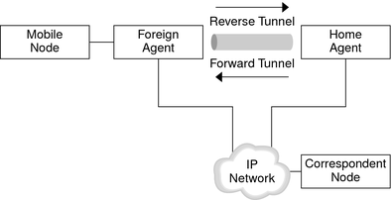
Reverse Tunneling

Slide 17
Applications & Challenges
Applications:
1.Database applications
2.Voice over IP
Challenges:
Triangle routing
Double Crossing

Slide 18
Challenges in Mobile IP (Inefficiencies in Mobile IP)

Slide 19
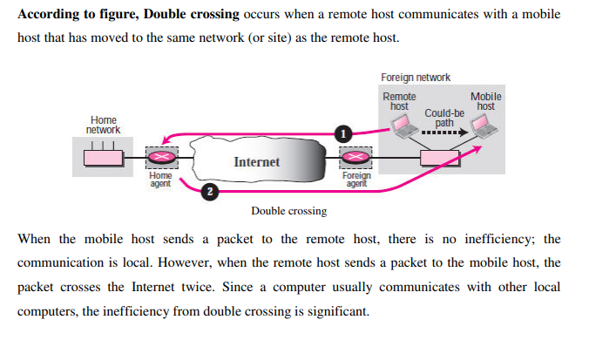
Double Crossing

Slide 20
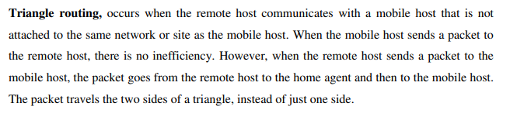
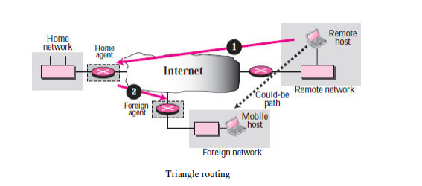
Triangle Routing

Slide 21
Solutions to these Inefficiencies
To address the "triangle routing" and "double crossing" issues in mobile networking, particularly within Mobile IP, the primary solution is to implement route optimization mechanisms, where the mobile node's current location is communicated to the correspondent node, allowing packets to be sent directly to the mobile node's current network instead of going through the home agent unnecessarily, effectively eliminating the "triangle" routing path.

Slide 22
Key points in solving the issues
Binding updates- The mobile node periodically informs its home agent about its current location (Foreign Agent) through "binding updates," which are then shared with the correspondent nodes.
Direct routing - Once the correspondent node receives the binding update, it can route packets directly to the mobile node's current network, avoiding the detour through the home agent.
Route optimization protocol- A dedicated protocol is often used to manage the exchange of binding information between the mobile node, home agent, and correspondent nodes, enabling efficient route optimization.

Slide 23
Benefits of this solution:
Eliminates triangle routing
Reduces network latency
Improves overall efficiency
Maintains security through controlled information sharing

Slide 24
IPV6
Unit 4
Mobile Computing

Slide 25
Understanding IPv4
An IP address (Internet Protocol address) is a unique identifier assigned to each device connected to a network that uses the Internet Protocol for communication. It serves two main purposes:
Identification: It uniquely identifies a device on a network.
Location Addressing: It indicates where a device is located within a network, making data routing possible.

Slide 26
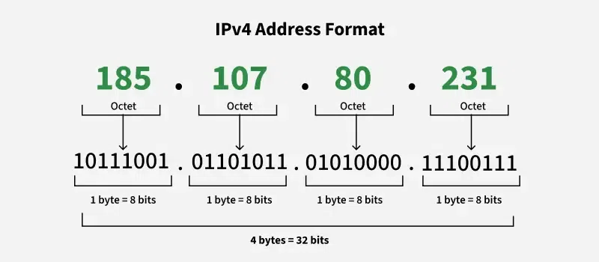
IPV4 format
IP stands for Internet Protocol version v4 stands for Version Four (IPv4), is the most widely used system for identifying devices on a network. It uses a set of four numbers, separated by periods (like 192.168.0.1), to give each device a unique address. This address helps data find its way from one device to another over the internet

Slide 27
Mobile IPv4
Mobile IPv4 is a protocol that enables devices to maintain their IP address and network connectivity while moving between different networks.
The main problem it solves is maintaining continuous network connections when a device changes its point of attachment to the internet. For example, when your phone moves from one Wi-Fi network to another, or from Wi-Fi to cellular data.

Slide 28
Mobile IP: Basic Operation –Agent Advertisement
Agent Advertisement
HA/FA periodically send advertisement messages into their physical subnets
Advertisement messages (ICMP messages) are like beacon broadcast into subnet.
The TTL(Time to live) field in packet is set to 1 – so that packet is not forwarded further.
The IP destination address – 224.0.0.1 – multicast address or 255.255.255.255 – broadcast address.
MN listens to these messages and detects, if it is in home/foreign network
MN reads a COA from the FA advertisement messages

Slide 29
Agent advertisement
0
7
8
15
16
23
24
31
type
code
checksum
#addresses
addr. size
lifetime
router address 1
preference level 1
router address 2
preference level 2
. . .
type
length
sequence number
registration lifetime
R
B
H
F
M
G
V
reserved
COA 1
COA 2
. . .

Slide 30
Mobile IP: Basic Operation –Agent Solicitation
Agent Solicitation
If no agent advertisements are present or the inter arrival time between two advertisements are too high – the mobile node must send agent solicitation.
Solicitation message – should not flood the network
A mobile node can send three solicitation every one second as soon as it enters into the foreign network.
If a node does not receive an answer to its solicitation it must decrease the rate of solicitation exponentially to avoid flooding the network.
Agent discovery can be done – for better connection.
Once agent is discovered mobile node will have COA.

Slide 31
Registration request
0
7
8
15
16
23
24
31
type
S
B
D
M
G
T
rx
lifetime
home address
home agent
COA
identification
extensions . . .
UDP packets are used for registration requests.
Source address – address of MN
Destination address –address of HA\FA (depending upon location of COA)
Type - set to 1 to denote registration request.
S – if MN want HA to retain prior mobility binding.
B – if set means MN – want to receive broadcast packet broadcasted into HN.
D- if set then MN will do De capsulation at the tunnel (in case of COA located at MN).
M\G – types of encapsulation
T – reverse tunneling

Slide 32
Registration request
0
7
8
15
16
23
24
31
type
S
B
D
M
G
T
rx
lifetime
home address
home agent
COA
identification
extensions . . .
Lifetime – denotes the validity of the registration in seconds
Home address – fixed IP address of MN
Home agent – IP address of home agent
COA – represents tunnel end point
Identification – 64 bit identification generated by MN to identify a request and match it with registration replies. – field is used to protect against replay attacks of registrations.

Slide 33
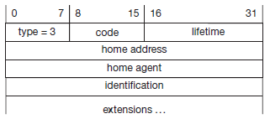
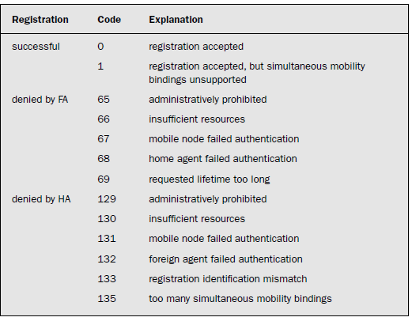
Registration reply
UDP packets are used for registration reply
Type field – set to 3 – indicating registration reply
Code – indicates result of registration request.

Slide 34
Types of Encapsulation
Three types
IP-in-IP encapsulation
Minimal encapsulation
Generic routing encapsulation
(The HA takes the original packet with the MN as destination, puts it into the data part of a new packet and sets the new IP header in such a way that the packet is routed to the COA)
The new header is also called the outer header.

Slide 35
IP-in-IP Encapsulation
original IP header
original data
new IP header
new data
outer header
inner header
original data

Slide 36
IP-in-IP encapsulation
IP-in-IP-encapsulation (mandatory in RFC 2003)
tunnel between HA and COA
ver.
IHL
TOS
length
32 bit word to specify IP version- IPv4 or IPv6
IP identification
flags
fragment offset
TTL
IP-in-IP
IP checksum
IP address of HA
Care-of address COA
ver.
IHL
TOS
length
IP identification
flags
fragment offset
TTL
lay. 4 prot.
IP checksum
IP address of CN
IP address of MN
TCP/UDP/ ... payload

Slide 37
IP-in-IP encapsulation
IP-in-IP-encapsulation (mandatory in RFC 2003)
tunnel between HA and COA
ver.
IHL
TOS
length
Length of the outer IP header (five words)
IP identification
flags
fragment offset
TTL
IP-in-IP
IP checksum
IP address of HA
Care-of address COA
ver.
IHL
TOS
length
IP identification
flags
fragment offset
TTL
lay. 4 prot.
IP checksum
IP address of CN
IP address of MN
TCP/UDP/ ... payload

Slide 38
IP-in-IP encapsulation
IP-in-IP-encapsulation (mandatory in RFC 2003)
tunnel between HA and COA
ver.
IHL
TOS
length
Differentiated services – copied from inner IP header
IP identification
flags
fragment offset
TTL
IP-in-IP
IP checksum
IP address of HA
Care-of address COA
ver.
IHL
TOS
length
IP identification
flags
fragment offset
TTL
lay. 4 prot.
IP checksum
IP address of CN
IP address of MN
TCP/UDP/ ... payload

Slide 39
IP-in-IP encapsulation
IP-in-IP-encapsulation (mandatory in RFC 2003)
tunnel between HA and COA
ver.
IHL
TOS
length
Length of complete encapsulated packet
IP identification
flags
fragment offset
TTL
IP-in-IP
IP checksum
IP address of HA
Care-of address COA
ver.
IHL
TOS
length
IP identification
flags
fragment offset
TTL
lay. 4 prot.
IP checksum
IP address of CN
IP address of MN
TCP/UDP/ ... payload

Slide 40
IP-in-IP encapsulation
IP-in-IP-encapsulation (mandatory in RFC 2003)
tunnel between HA and COA
ver.
IHL
TOS
length
A 32 bit word to specify the ID for the packet, flags, and fragment offset for the same packet ID (a packet can be transmitted in fragments)
IP identification
flags
fragment offset
TTL
IP-in-IP
IP checksum
IP address of HA
Care-of address COA
ver.
IHL
TOS
length
IP identification
flags
fragment offset
TTL
lay. 4 prot.
IP checksum
IP address of CN
IP address of MN
TCP/UDP/ ... payload

Slide 41
IP-in-IP encapsulation
IP-in-IP-encapsulation (mandatory in RFC 2003)
tunnel between HA and COA
ver.
IHL
TOS
length
A 32 bit word, to specify number of attempts to hop before expiry of packets at the network, type of protocol, and checksum of the header (for finding transmission errors)
IP identification
flags
fragment offset
TTL
IP-in-IP
IP checksum
IP address of HA
Care-of address COA
ver.
IHL
TOS
length
IP identification
flags
fragment offset
TTL
lay. 4 prot.
IP checksum
IP address of CN
IP address of MN
TCP/UDP/ ... payload

Slide 42
IP-in-IP encapsulation
IP-in-IP-encapsulation (mandatory in RFC 2003)
tunnel between HA and COA
ver.
IHL
TOS
length
A 32 bit word, to specify the IP address of the home agent.
IP identification
flags
fragment offset
TTL
IP-in-IP
IP checksum
IP address of HA
Care-of address COA
ver.
IHL
TOS
length
IP identification
flags
fragment offset
TTL
lay. 4 prot.
IP checksum
IP address of CN
IP address of MN
TCP/UDP/ ... payload

Slide 43
IP-in-IP encapsulation
IP-in-IP-encapsulation (mandatory in RFC 2003)
tunnel between HA and COA
ver.
IHL
TOS
length
A 32 bit word, to specify IP address of the destination COA
IP identification
flags
fragment offset
TTL
IP-in-IP
IP checksum
IP address of HA
Care-of address COA
ver.
IHL
TOS
length
IP identification
flags
fragment offset
TTL
lay. 4 prot.
IP checksum
IP address of CN
IP address of MN
TCP/UDP/ ... payload

Slide 44
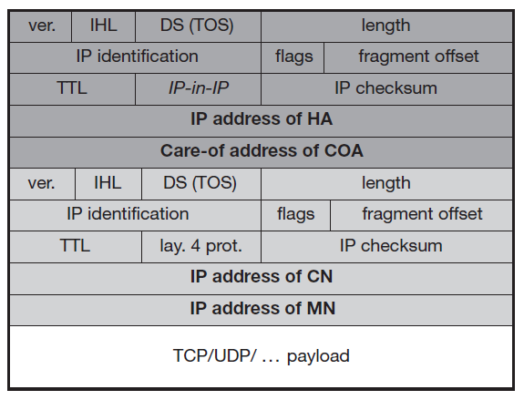
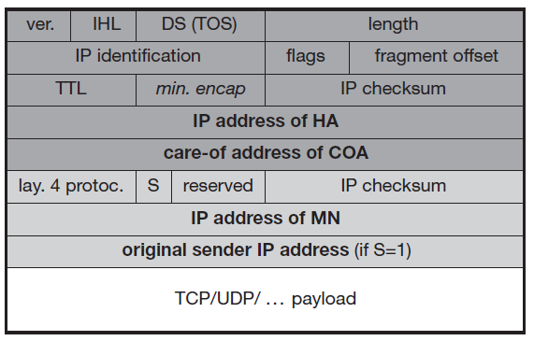
Minimal Encapsulation
In IP-in-IP encapsulation many fields are redundant.
Minimal encapsulation
IP-in-IP encapsulation

Slide 45
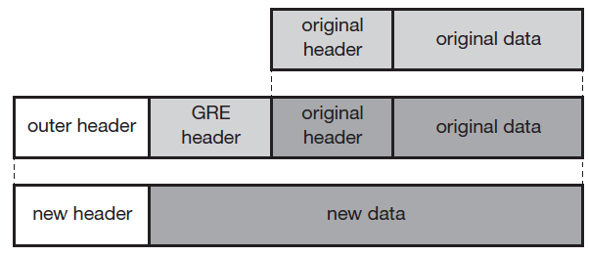
Generic Routing Encapsulation
IP-in-IP encapsulation and minimal encapsulation works only for IP
Generic routing encapsulation – supports other network layer protocols in addition to IP.
GRE allows encapsulation of one protocol suite into the payload portion of a packet of another protocol suite.

Slide 46
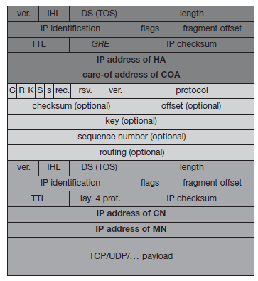
Generic Routing Encapsulation
Outer header is standard IP header.
TTL, TOS copied from original IP header.

Slide 47
Mobile IPv4 Summary
Mobile node moves to new location
Agent Advertisement by foreign agent
Registration of mobile node with home agent
Proxying by home agent for mobile node
Encapsulation of packets
Tunneling by home agent to mobile node via foreign agent
Optimizations for triangular routing
Reverse tunneling

Slide 48
Mobile IP and IPv6
In IPV6 security is integrated and not an add-on, authentication of registration is included.
COA can be assigned via auto-configuration (DHCPv6 is one candidate), every node has address auto-configuration
No need for a separate FA, all routers perform router advertisement which can be used instead of the special agent advertisement
MN can signal a sender directly the COA, sending via HA not needed in this case (automatic path optimization)
“soft” hand-over, i.e. without packet loss, between two subnets is supported
MN sends the new COA to its old router
the old router encapsulates all incoming packets for the MN and forwards them to the new COA
authentication is always granted

Slide 49
DHCP
Dynamic host configuration protocol – standardized networking protocol used by servers on an IP network to allocate IP addresses to computer.
The purpose of DHCP is to automate the IP address configuration of a computer without a network administrator.
IP addresses are typically selected from a range of assigned IP addresses stored in a database on the server and issued to a computer which requests a new IP address.
An IP address is assigned to a computer for a set interval, after which, the computer must renew the IP address or acquire a new one.

Slide 50
DHCP
If a new computer is connected to a network, DHCP can provide it with all the necessary information for full system integration into the network,
Addresses of a DNS server
The default router,
the subnet mask,
the domain name, and an
IP address.

Slide 51
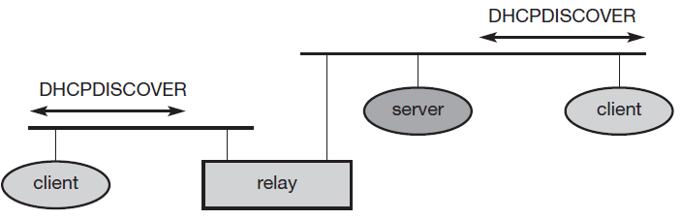
DHCP
DHCP is based on a client/server model.
DHCP clients send a request to a server (DHCPDISCOVER in the example) to which
the server responds.
A client sends requests using MAC broadcasts to reach all devices in the LAN.
A DHCP relay might be needed to forward requests across inter-working units to a DHCP server.

Slide 52
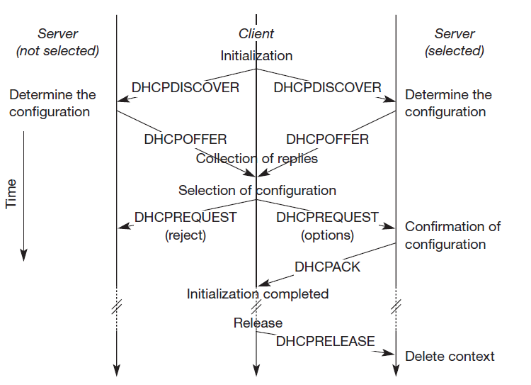
DHCP

Slide 53
DHCP
The previous figure shows one client and two servers.
The client broadcasts a DHCPDISCOVER into the subnet.
In the case shown, two servers receive this broadcast and determine the configuration they can offer to the client.
Servers reply to the client’s request with DHCPOFFER and offer a list of configuration parameters.
The client in turn replies to the servers, accepting one of the configurations and rejecting the others using DHCPREQUEST.
If a server receives a DHCPREQUEST with a rejection, it can free the reserved configuration for other possible clients.

Slide 54
DHCP
The server with the configuration accepted by the client now confirms the configuration with DHCPACK.
If a client leaves a subnet, it should release the configuration received by the server using DHCPRELEASE
The configuration a client gets from a server is only leased for a certain amount of time, it has to be reconfirmed from time to time.
DHCP is a good candidate for supporting the acquisition of care-of addresses for mobile nodes.
Without authentication, the mobile node cannot trust a DHCP server, and the DHCP server cannot trust the mobile node.

Slide 55
Mobile Transport Layer
Supporting mobility only on lower layers up to the network layer is not enough to provide mobility support for applications.
Two functions of the transport layer in the internet are
Checksumming over user data
Multiplexing/Demultiplexing of data from/to applications.
While the network layer only addresses a host, ports in UDP or TCP allow dedicated applications to be addressed.
UDP
Only addressing
Connectionless/No reliability

Slide 56
UDP Vs TCP
The main difference between UDP and TCP is that TCP offers connections between two applications.
Within a connection TCP can give certain guarantees, such as in-order delivery or reliable data transmission using retransmission techniques.
TCP has built-in mechanisms to behave in a ‘network friendly’ manner.
If, for example, TCP encounters packet loss, it assumes network internal congestion and slows down the transmission rate.
This is one of the main reasons to stay with protocols like TCP

Slide 57
UDP Vs TCP
UDP requires that applications handle reliability, in-order delivery etc.
UDP does not behave in a network friendly manner, i.e., does not pull back in case of congestion and continues to send packets into an already congested network.
The main problem with many mechanisms is that they have been designed for situations that are completely
different from those in mobile networks.
Efforts to adapt TCP to emerging 3G and 4G networks

Slide 58
Traditional TCP
Congestion Control
TCP has been designed for fixed networks with fixed end-systems.
hardware typically works without introducing transmission errors
probable reason for a packet loss in a fixed network is a temporary overload some point in the transmission path
Router drops packets due to congestion
How does the sender comes to know of packet loss?
Missing acknowledgement

Slide 59
Traditional TCP
Retransmitting the missing packet and continuing at full sending rate ?? Right or Wrong
To mitigate congestion, TCP slows down the transmission rate dramatically.
Slow Start
The behaviour TCP shows after the detection of congestion is called slow start.
The sender always calculates a congestion window for a receiver.
The start size of the congestion window is one segment (TCP packet).
The sender sends one packet and waits for acknowledgement.

Slide 60
Traditional TCP ( Slow Start)
If this acknowledgement arrives,the sender increases the congestion window by one, now sending two packets (congestion window = 2).
doubles the congestion window every time the acknowledgements come back.
Called the exponential growth of the congestion window in the slow start mechanism.
Steps becomes too large
Stops at congestion window= congestion threshold
After that linear increase till the sender notices
1. Time-out due to a missing acknowledgement
2. Continuous acknowledgements for the same
packet

Slide 61
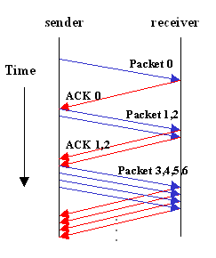
Traditional TCP ( Slow Start)
Congestion threshold is set to half of the current congestion window.
The congestion window itself is set to one segment and the sender starts sending a single segment

Slide 62
Fast Re-transmit / Fast Recovery
TCP sends an acknowledgement only after receiving a packet
If a sender receives several acknowledgements for the same packet, this is due to a gap in received packets at the receiver
however, the receiver got all packets up to the gap and is actually receiving packets
Packet loss is not due to congestion, but due to a transmission error,
Continue with current congestion window (do not use slow-start)
The sender can now retransmit the missing packet before the timer expires.
This behavior is known as fast retransmit.

Slide 63
Fast Re-transmit / Fast Recovery
The sender performs a fast recovery from the packet loss
The other reason for activating slow start is a time-out due to a missing acknowledgement.
TCP using fast retransmit/fast recovery interprets this as congestion in the network and activates the slow start mechanism

Slide 64
Implications on Mobility
Slow start is one of the most useful mechanisms in fixed networks, it drastically decreases the efficiency of TCP if used together with mobile receivers or senders. Why??
Reason: Use of slow-start under wrong assumptions
What are the wrong assumptions?
From a missing acknowledgement TCP assumes congestion.
Error rates in wireless links are orders of magnitude than wired links
Packet loss due to mobility
Mobile IP for packets in transit to old foreign agent , when node already moved away to another foreign node

Slide 65
Implications on Mobility
TCP cannot distinguish between these two different reasons.
Cannot change TCP completely just to support mobile users or wireless links.
An error control mechanism (missing acknowledgement due to a transmission error) is misused for congestion control (missing acknowledgement due to network overload

Slide 66
TCP Improvements: Indirect TCP
Indirect TCP or I-TCP segments the connection
no changes to the TCP protocol for hosts connected to the wired Internet, millions of computers use (variants of) this protocol
optimized TCP protocol for mobile hosts
splitting of the TCP connection at, e.g., the foreign agent into 2 TCP connections, no real end-to-end connection any longer
hosts in the fixed part of the net do not notice the characteristics of the wireless part
mobile host
access point
(foreign agent)
„wired“ Internet
„wireless“ TCP
standard TCP

Slide 67
TCP Improvements: Indirect TCP
The correspondent host in the fixed network does not notice the wireless link or the segmentation of the connection.
Keypoints:
If the correspondent host sends a packet, the foreign agent acknowledges this packet and tries to forward the packet to the mobile host.
Packet Loss in the wired network is handled by the foreign agent( Mobile Node -> Wireless Node)
During handover the sockets of the proxy(foreign agent) too might migrate to the new foreign agents
The socket reflects the current state of the TCP connection,i.e., sequence number, addresses, ports etc

Slide 68
Advantages of I-TCP
I-TCP does not require any changes in the TCP protocol as used by the hosts in the fixed network or other hosts in a wireless network that do not use this optimization.
Due to the strict partitioning into two connections, transmission errors on the wireless link, i.e., lost packets, cannot propagate into the fixed network.
Without partitioning, retransmission of lost packets would take place between mobile host and correspondent host across the whole network.
It is always dangerous to introduce new mechanisms into a huge network such as the internet without knowing exactly how they will behave.

Slide 69
Advantages of I-TCP
The short delay between the mobile host and foreign agent could be determined- recovering faster from packet loss.
Partitioning into two connections also allows the use of a different transport layer protocol between the foreign agent and the mobile host or the use of compressed headers etc. The foreign agent can now act as a gateway to translate between the different protocols.

Slide 70
Disadvantages of I-TCP
The loss of the end-to-end semantics of TCP might cause problems if the foreign agent partitioning the TCP connection crashes.
The correspondent node does not know anything about the partitioning, so a crashing access node may also crash applications running on the correspondent node assuming reliable end-to-end delivery.
Increased handover latency may be much more problematic.
Buffering of packets at foreign agent till acknowledgments received from mobile node
In meantime if handover occurs for mobile node, packets need to be buffered for more time, so other incoming packets cannot be buffered

Slide 71
Disadvantages of I-TCP
The foreign agent must be a trusted entity because the TCP connections end at this point. If users apply end-to-end encryption, the foreign agent has to be integrated into all security mechanisms.

Slide 72
TCP Improvements :Snooping TCP
One of the drawbacks of I-TCP is the segmentation of the TCP into two TCP connections – losing end-to end TCP semantics.
In this approach, the foreign agent buffers all packets with destination mobile host and additionally ‘snoops’ the packet flow in both directions to recognize acknowledgements.
The foreign agent buffers every packet until it receives an acknowledgement from the mobile host

Slide 73
TCP Improvements :Snooping TCP
Transparent“ extension of TCP within the foreign agent
buffering of packets sent to the mobile host
lost packets on the wireless link (both directions!) will be retransmitted immediately by the mobile host or foreign agent, respectively (so called “local” retransmission)
the foreign agent therefore “snoops” the packet flow and recognizes acknowledgements in both directions, it also filters ACKs
local retransmission
correspondent
host
foreign
agent
„wired“ Internet
snooping of ACKs
buffering of data
mobile
host
end-to-end TCP connection

Slide 74
Snooping TCP
Data transfer to the mobile host
FA buffers data until it receives ACK of the MH, FA detects packet loss via duplicated ACKs or time-out
fast retransmission possible, transparent for the fixed network
Data transfer from the mobile host
FA detects packet loss on the wireless link via sequence numbers, FA answers directly with a NACK to the MH
MH can now retransmit data with only a very short delay
Integration of the MAC layer
MAC layer often has similar mechanisms to those of TCP
thus, the MAC layer can already detect duplicated packets due to retransmissions and discard them

Slide 75
Advantages
To remain transparent the foreign agent must not acknowledge data to the corresponding host- no violation of end to end semantic.

Slide 76
Mobile TCP
Why MTCP?
Improve overall throughput
To lower the delay
To maintain end-to-end semantics of TCP,
To provide a more efficient handover.
Additionally, M-TCP is especially adapted to the problems arising from lengthy or frequent disconnections

Slide 77
Mobile TCP
M-TCP splits as I-TCP does
unmodified TCP fixed network to supervisory host (SH)
optimized TCP SH to MH
Supervisory host
no caching, no retransmission
monitors all packets, if disconnection detected
set sender window size to 0
sender automatically goes into persistent mode,where its state cannot change.
As soon as connectivity is detected again, the SH reopens the window at its old value, so that the sender can continue to send at full speed.
A packet lost on the wireless link has to be retransmitted by the original sender to maintain the TCP end-to-end semantics

Slide 78
M-TCP
The advantages of M-TCP are as follows:
It maintains TCP end-to-end semantics, since the SH does not send any ACK, but just forwards the same from the MH.
It supports disconnection, by avoiding useless retransmissions, slow starts or breaking connections, by simply shrinking the sender’s window size.
No buffering is done in the SH, only forwarding

Slide 79
M-TCP
Disadvantages
Since the SH does not act as a proxy as in I-TCP, packet loss on the wireless link is propagated into the fixed network.
Modifications are required in the MH protocol software and also on new network elements like the bandwidth manager

Slide 80
Fast retransmit/fast recovery
To artificially force the fast retransmit behaviour on the mobile host and correspondent host side.
As soon as the mobile host registers at a new foreign agent using mobile IP, it starts sending duplicated acknowledgements to correspondent hosts.
The proposal is to send three duplicates.
This forces the corresponding host to go into fast retransmit mode and not to start slow start,

Slide 81
Fast retransmit/fast recovery
Advantages
Simplicity
Disadvantages
Forcing fast retransmission increases the efficiency, but retransmitted packets still have to cross the whole network between Correspondent host and mobile host.
If the handover from one foreign agent to another takes a longer time, the correspondent host will have already started retransmission.
approach focuses on loss due to handover: packet loss due to problems on the wireless link is not considered

Slide 82
Transmission/Timeout Freezing
While the approaches presented so far can handle short interruptions of the connection,
due to handover
transmission errors on the wireless link
But for longer interruptions of transmission eg like driving into a tunnel, or user moving into a cell which has no with no capacity left over
The MAC layer has already noticed connection problems, before the connection is actually interrupted from a TCP point of view.
The MAC layer can inform the TCP layer of an upcoming loss of connection or that the current interruption is not caused by congestion.
TCP can now stop sending and ‘freezes’ the current state of its congestion window and further timers

Slide 83
Transmission/Timeout Freezing
As soon as the MAC layer detects connectivity again, it signals TCP that it can resume operation at exactly the same point where it had been forced to stop.
For TCP time simply does not advance, so no timers expire.
The advantage of this approach is that it offers a way to resume TCP connections even after longer interruptions of the connection.
It is independent of any other TCP mechanism, such as acknowledgements or sequence numbers, so it can be used together with encrypted data
Disadvantages
All mechanisms rely on the capability of the MAC layer to detect future interruptions.
Freezing the state of TCP does not help in case of some encryption schemes that use time-dependent random numbers.

Slide 84
Selective retransmission
TCP acknowledgements are cumulative, i.e., they acknowledge in-order receipt of packets up to a certain packet.
If a single packet is lost, the sender has to retransmit everything starting from the lost packet.
This method wastes the bandwidth for any kind of network.
TCP can indirectly request a selective retransmission of
of packets.
The sender can now determine precisely which packet is needed and can retransmit it.

Slide 85
Selective retransmission
The advantage of this approach is obvious: a sender retransmits only the lost packets.
This lowers bandwidth requirements and is extremely helpful in slow wireless links.
Disadvantage
More complex software on the receiver side, because now more buffer is necessary to resequence data and to wait for gaps to be filled
But while memory sizes and CPU performance permanently increase, the bandwidth of the air interface remains almost the same.

Slide 86
Transaction-Oriented TCP
Assume an application running on the mobile host that sends a short request to a server from time to time, which responds with a short message.
If the application requires reliable transport of the packets, it may use TCP.
Using TCP now requires several packets over the wireless link.
First, TCP uses a three-way handshake to establish the connection.
At least one additional packet is usually needed for transmission of the request, and requires three more packets to close the connection via a three-way handshake.
But in an example of only one data packet, TCP may need seven packets altogether.

Slide 87
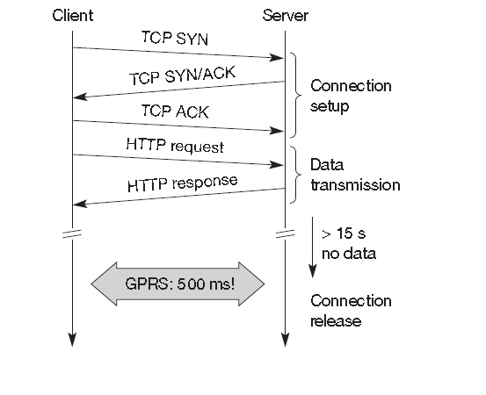
Transaction-Oriented TCP

Slide 88
Transaction-Oriented TCP
This led to the development of a transaction-oriented TCP (T/TCP, RFC 1644 (Braden, 1994)).
T/TCP can combine packets for connection establishment and connection release with user data packets.
This can reduce the number of packets down to two instead of seven.
Advantage for certain applications is the reduction in the overhead which standard TCP has for connection setup and connection release.
T/TCP is not the original TCP anymore, so it requires changes in the mobile host and all correspondent hosts, which is a major disadvantage.

Slide 89
TCP over 2.5 G/3 G networks
The following characteristics have to be considered when deploying applications over 2.5G/3G wireless links:
Data rates:
While typical data rates of today’s 2.5G systems are 10–20 kbit/s uplink and 20–50 kbit/s downlink, 3G and future 2.5G systems will initially offer data rates around 64 kbit/s uplink and 115–384 kbit/s downlink.
Typically, data rates are asymmetric as it is expected that users will download more data compared to uploading. Uploading is limited by the limited battery power
Serious problems that may reduce throughput dramatically are bandwidth oscillations due to dynamic resource sharing.

Slide 90
Characteristics
Latency:
All wireless systems comprise elaborated algorithms for error correction and protection, such as forward error correction (FEC), checksumming, and interleaving.
FEC and interleaving let the round trip time (RTT) grow to several hundred milliseconds up to some seconds
Jitter:
Wireless systems suffer from large delay variations or ‘delay spikes’.
Reasons for sudden increase in the latency are: link outages due to temporal loss of radio coverage, blocking due to high-priority traffic, or handovers.
Packet loss:
Packets might be lost during handovers or due to corruption.
Thanks to link-level retransmissions the loss rates of 2.5G/3G systems due to corruption are relatively low

Slide 91
Configuration Parameters to adapt to TCP environments
Large windows:
TCP should support large enough window sizes based on the bandwidth delay product experienced in wireless systems.
A larger initial window (more than the typical one segment) of 2 to 4 segments may increase performance particularly for short transmissions
Limited transmit:
This mechanism, defined in RFC 3042 (Allman, 2001) is an extension of Fast Retransmission/Fast Recovery.
Is particularly useful when small amounts of data are to be transmitted.
Large MTU:
The larger the MTU (Maximum Transfer Unit) the faster TCP increases the congestion window.
Link layers fragment PDUs for transmission anyway according to their needs and large MTUs may be used to increase performance.

Slide 92
(Continued….)
Selective Acknowledgment
Always beneficial compared to the cumulative acknowledgement
Explicit Congestion Notification
a receiver to inform a sender of congestion in the network by setting the ECN-Echo flag on receiving an IP packet that has experienced congestion.
Timestamp
TCP connections with large windows may benefit from more frequent RTT samples provided with timestamps by adapting quicker to changing network conditions
No header compression
TCP header compression mechanism according to RFC 1144 does not perform well in the presence of packet losses this mechanism should not be used

Slide 93
Performance Enhancing Proxies
located in the transport and application layer.
One of the key features of a proxy is its transparency with respect to the end systems, the applications and the users.
However, all proxies share a common problem as they break the end-to-end semantics of a connection.
Not suitable for use with IP Security

Slide 94
End

